Slide 1
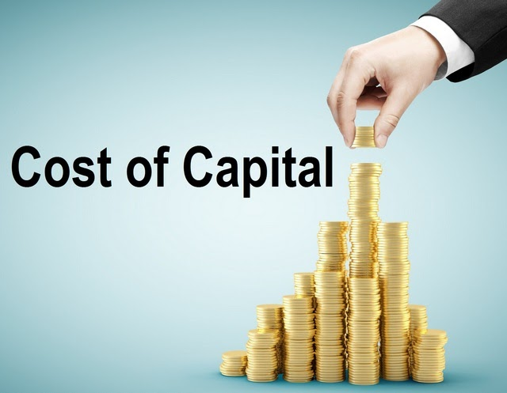

Slide 2
Introduction
Cost of capital is the rate of return a company must earn on its investments to meet the expectations of its investors or lenders. It represents the cost of raising funds, whether through equity (shares) or debt (loans).
It is an important concept in financial management because it helps a company decide whether an investment or project is worthwhile. If the expected return is higher than the cost of capital, the project adds value; if it is lower, the project may lead to losses.
In simple words, the cost of capital acts as a benchmark that guides companies in making smart financial decisions and maximizing shareholder wealth.

Slide 3
Definition by Different Theorists
According to Richard A. Brealey and Stewart C. Myers, "The cost of capital is the rate of return that a firm must earn on its investment in order to maintain its market value and attract funds.“
According to Van Horne, "Cost of capital is the minimum required rate of return on investment that will satisfy the providers of capital.“
According to Pandey I.M., "Cost of capital refers to the minimum rate of return that a company must earn on its investment to cover the cost of financing."

Slide 4
Importance of Cost of Capital
It helps in evaluating whether an investment or project is worthwhile by comparing expected returns with the cost of capital.
It assists in determining the optimal mix of debt and equity to minimize overall financing costs.
It guides financial planning and decision-making for raising funds, financing projects, and managing dividends.
It aids in assessing the performance of different divisions or investment opportunities within a company.
It ensures that resources are allocated to projects that maximize shareholder wealth and support long-term growth.

Slide 5
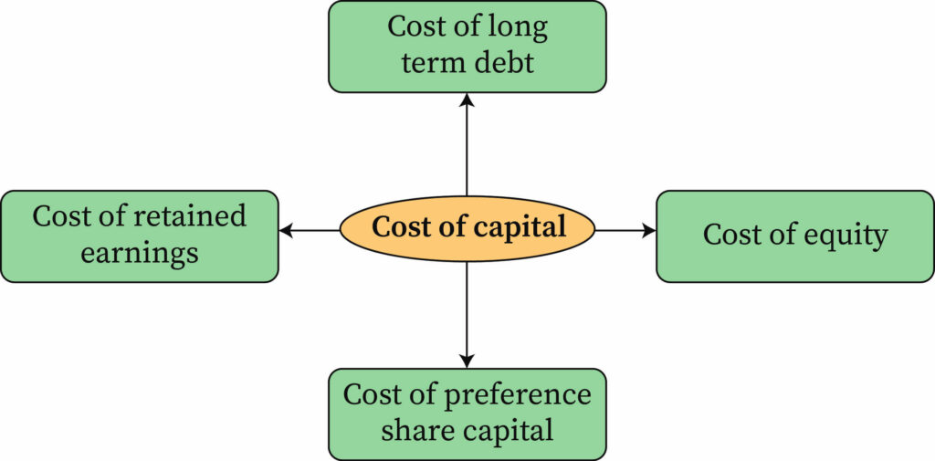
Components of Cost of Capital
The cost of capital is made up of different components, depending on the sources of funds a company uses. The main components of cost of capital are:

Slide 6
Cost of Debt (Kd)
The cost of debt is the effective rate a company pays on its borrowed funds, such as loans, debentures, or bonds. Since interest on debt is tax-deductible, the after-tax cost of debt is usually considered. It is generally lower than equity because debt holders have a prior claim on assets in case of liquidation, making it less risky for them. The cost of debt is important for financial planning because excessive borrowing increases financial risk. Companies aim to manage debt efficiently to balance risk and cost.
Cost of Preference Shares (Kp)
Preference shares are a type of equity that pays a fixed dividend to shareholders. The cost of preference shares is the dividend paid divided by the net issue price of the shares. Unlike debt, preference dividends are not tax-deductible, making their cost slightly higher than debt. Preference shareholders have priority over equity shareholders in receiving dividends, but do not usually have voting rights. Calculating the cost of preference shares helps a company decide whether issuing these shares is financially viable.

Slide 7
Cost of Equity (Ke)
The cost of equity represents the return expected by equity shareholders who invest in the company. Equity investors take a higher risk because they are paid after debt and preference shareholders. Different Methods be used to estimate it. A higher cost of equity indicates higher expectations from investors due to perceived risks. Understanding the cost of equity is crucial for making investment and financing decisions that satisfy shareholders.
Cost of Retained Earnings
Retained earnings are profits kept in the business instead of being distributed as dividends. They have an opportunity cost because shareholders could have earned returns if they received the profits as dividends and invested them elsewhere. The cost of retained earnings is generally considered equal to the cost of equity. Using retained earnings avoids external financing costs and interest payments. Properly managing retained earnings helps a company fund growth while maintaining shareholder satisfaction.

Slide 8

Methods of Calculating Cost of Capital
The cost of capital can be calculated using different methods depending on the type of capital—debt, preference shares, or equity. There are two methods for calculating the cost of capital. These are:
1. Weighted Average Cost of Capital (WACC)
2. Specific Cost Method

Slide 9

Weighted Average Cost of Capital (WACC)
Weighted Average Cost of Capital (WACC) is the overall cost of capital for a company that uses multiple sources of finance, such as debt, preference shares, and equity. It represents the average rate of return a company is expected to pay to all its investors, weighted according to the proportion of each type of capital in the total capital structure.
WACC is important because it acts as a benchmark or “hurdle rate” for evaluating investment projects. A project should be accepted only if its expected return is higher than the WACC, ensuring that the investment creates value for the company.
$$\text{WACC}=\frac{E}{V}×Ke+\frac{P}{V}×Kp+\frac{D}{V}×Kd×\left(1−T\right)$$
Where:
$E$= Market value of equity $P$= Market value of preference shares
$D$= Market value of debt $V=E+P+D$= Total capital
$Ke$= Cost of equity $Kp$= Cost of preference shares
$Kd$= Cost of debt $T$= Corporate tax rate
By calculating WACC, a company can make informed decisions about financing and investments, aiming to minimize costs and maximize shareholder wealth.

Slide 10

Simple Cost Method
The Simple Cost Method of calculating the cost of capital is the most basic approach. In this method, the cost of each source of capital (like debt, preference shares, or equity) is calculated separately without considering their proportion in the capital structure. After that, the overall cost of capital is estimated as a simple average of these costs.
For example, if a company uses only equity and debt, the cost of capital is calculated as:
$$\text{S}\text{imple} \text{Cost} \text{of} \text{Capital}=\frac{Ke+Kd}{2}$$
where $Ke$ is the cost of equity and $Kd$ is the cost of debt.
This method is easy to use but not very accurate because it does not take into account the actual weights (proportion) of each source of finance in the total capital. That’s why in practice the Weighted Average Cost of Capital (WACC) method is more widely used.

Slide 11
Factors Affecting Cost of Capital
Risk profile of the firm – Higher business or financial risk increases the cost of capital
Capital structure – The mix of debt and equity financing influences the overall cost
Market conditions – Prevailing interest rates and stock market trends affect the cost
Inflation rate – Higher inflation raises required returns, increasing the cost of capital
Company’s creditworthiness – Strong credit ratings reduce borrowing costs
Tax policy – Tax benefits on interest payments lower the effective cost of debt
Dividend policy – High dividend payouts can increase the expected return of shareholders
Government policies & regulations – Changes in financial regulations impact financing costs

Slide 12
Conclusion
Cost of capital is crucial for financial decisions as it sets the minimum return required for investments. It helps managers decide whether to accept or reject projects by acting as a benchmark for profitability. This ensures that resources are allocated efficiently to the most productive ventures, thereby improving the overall profitability of the business. At the same time, it guides firms in choosing the right mix of debt and equity financing, helping them balance risk and return effectively. By lowering financing costs and optimizing investment decisions, the cost of capital contributes to sustainable financial performance. Ultimately, it plays a key role in enhancing shareholder wealth and supporting the long-term growth of the organization.

